Slide 1
To our lesson
Teachers: Nguyen Thi Hong Nga

Slide 2
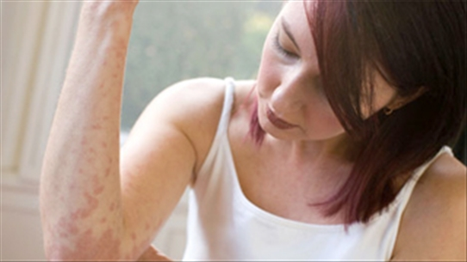
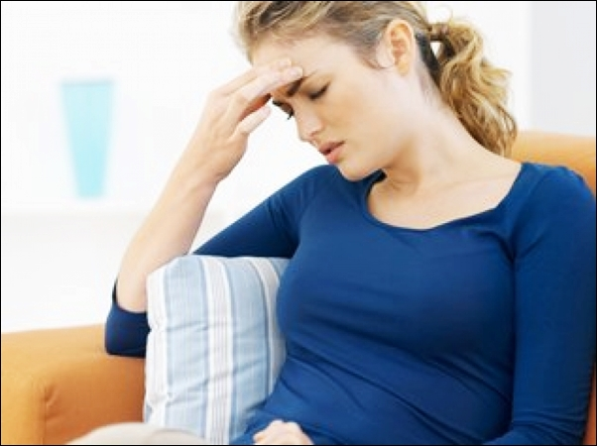
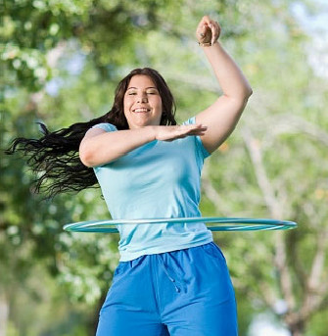
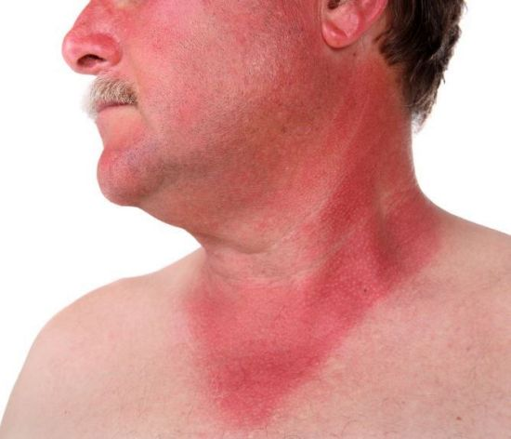
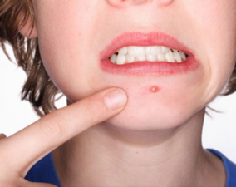
Warm up:
Look and write the names of the health problems
(an) allergy
sickness
flu
1. …………………
2. ………………….
3. …………….
(put on) weight
sunburn
spots/pimples
4. ……………………
5. ………………
6. ………………

Slide 3
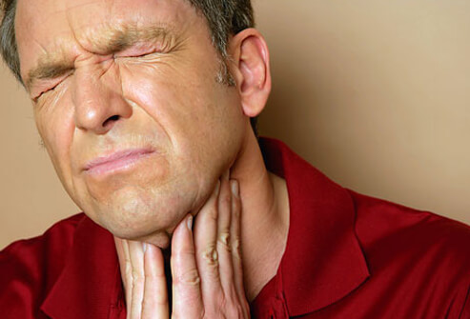
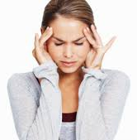
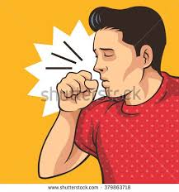
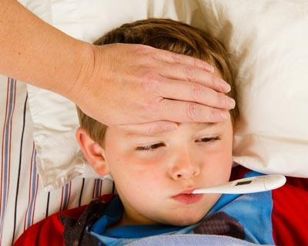
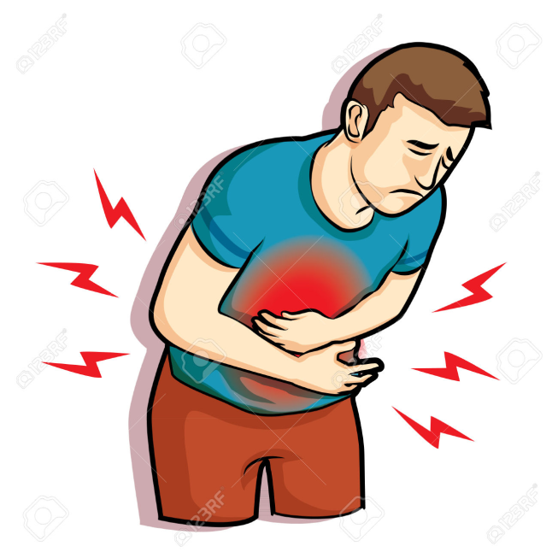
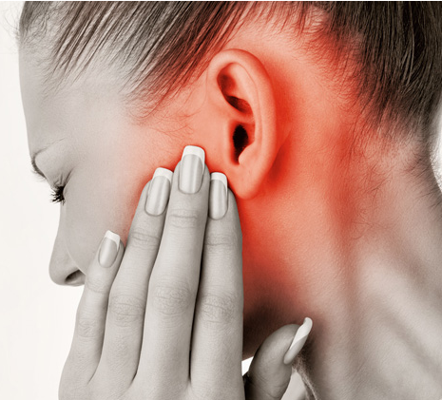
a sore throat
a headache
a cough
7. …………………
8. ………………….
9. …………….
a temperature
a stomachache
an earache
10. …………………
11. …………………….
12. ………………..

Slide 4
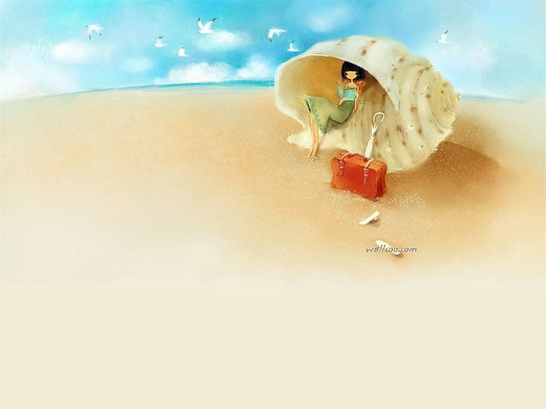
NEW LESSON
Unit 2:
HEALTH
A CLOSER LOOK 1

Slide 5
* Vocabulary
sunburn cough allergy
headache toothache sick
earache weak dizzy
sore throat temperature stomachache
(the) flu spots tired
itchy

Slide 6
Have a / an + an acute disease (bệnh cấp tính – số ít)
Ex: Have a cold / a headache / an earache / a toothache / a backache / a stomachache / a sore throat / a sore eye / a running nose / a cough / a temperature / a sunburn
Have + disease (không xác định hoặc số nhiều)
Ex: Have earache (we have two ears) / toothache (we have a lot of teeth), sore eye (we have two eyes) / sunburn / (the) flu (indefinite) / spots (pimples) (plural)
Feel + Adjective
Ex: Feel sick / tired / bored / dizzy / weak / itchy / excited / worried / good / well….

Slide 7
1. Put the words about health problems into correct columns.
Have a / an | have | feel
cough
headache
toothache
earache
sore throat
temperature
stomachache
allergy
……
(the) flu
spots
sunburn
toothache
earache
…
sick
tired
weak
dizzy
itchy
…

Slide 8
2. Now, read the doctor’s note about his patients and fill in the missing words.
P 1: She looks very red. She was outdoors all day yesterday. I think she has…………....
P 2: He keeps sneezing and coughing. I think he has ……………
P 3: He looks so ………. He can’t keep his eyes open! He is very hot too – he has a …………..…
P 4: He ate some seafood yesterday. Now he feels ………. He says he has a ………………
P 5: He is holding his neck. I think he has a ……………….
sunburn
(the) flu
tired
temperature
sick
stomachache
sore throat

Slide 9
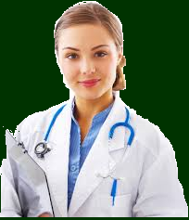
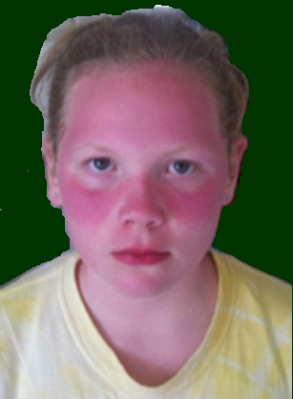
3. Role – play the meeting with the doctor. Use the cue in 1,2 or your own health problems
Hi, Hung.
Hi, doctor Thao.
I was outside all day yesterday. I feel very hot and my face is red.
I see. I think you have a sunburn.

Slide 10
3. Role – play the meeting with the doctor. Use the cue in 1,2 or your own health problems
You: Hi doctor Thao.
Doctor: Hi, …………………….……….
You: I was outside all day yesterday.
I feel very hot and my face is red.
Doctor: I see. I think you have a sunburn.

Slide 11
4. Choose a health problem. Work in groups. Tell your group about the last time you had that problem.
Example:
A: I had flu two weeks ago.
B: Me too! I felt so weak.
C: Oh. I had a sore throat yesterday.
D: I had toothache. I think I ate too many sweets.
Can you extend your conversation?

Slide 12
* PRONUNCIATION
1. Listen and circle the words you hear.
 | /f/ | /v/
1. | Fat | Vat
2. | Ferry | Very
3. | Fast | Vast
4. | Fault | Vault
5. | Safe | Save
6. | Leaf | Leave
Fat
Ferry
Vast
Vault
Save
Leave

Slide 13
6. Listen and circle the word(s) with the /f/ or /v/ sounds. Then say the sentences.
/f/
/f/
Fast food isn't healthy.
I have felt sick all day.
Obesity is a problem - people are getting fatter.
Having a healthy lifestyle is important.
Too many sweets give you toothache.
/v/
/f/
/f/
/v/
/f/
/v/

Slide 14
HOMEWORK
- Learn new words by heart.
- Practise the exercises again.
- Prepare: A closer look 2.

Slide 15
Goodbye!
See you again!

